Slide 1
Three Phase Induction Motors

Slide 2
CONTENTS
Three Phase Induction Motors:
Construction
working principle of three phase
induction motor
Torque and Torque-Slip characteristics.

Slide 3
INTRODUCTION
The three-phase induction motors are the most widely used electric motors in industry. They run at essentially constant speed from no-load to full-load.
However, the speed is frequency dependent and consequently these motors are not easily adapted to speed control.

Slide 4
Advantages
It has simple and rugged construction.
It is relatively cheap.
It requires little maintenance.
It has high efficiency and reasonably good power factor.
It has self starting torque.
Disadvantages
It is essentially a constant speed motor and its speed cannot be changed easily.
Its starting torque is inferior to d.c shunt motor.

Slide 5
Construction
A 3-phase induction motor has two main parts (1) stator and (2) rotor.
The rotor is separated from the stator by a small air-gap which ranges from 0.4 mm to 4 mm, depending on the power of the motor.

Slide 6
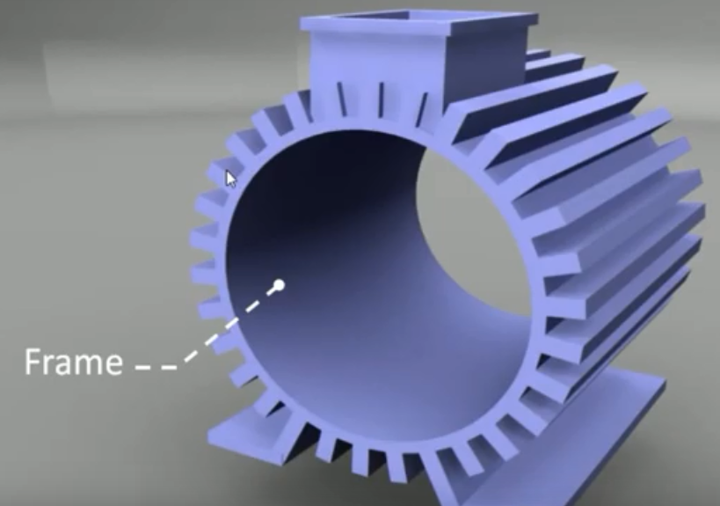

Slide 7
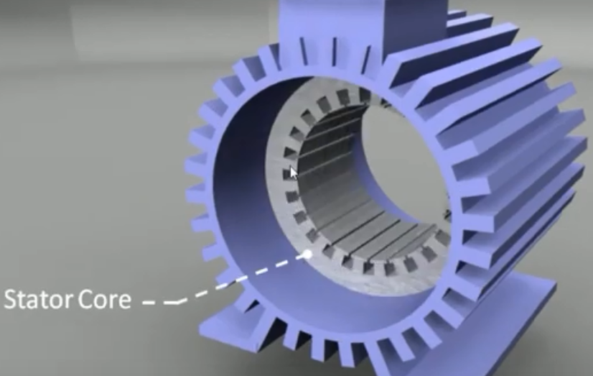

Slide 8
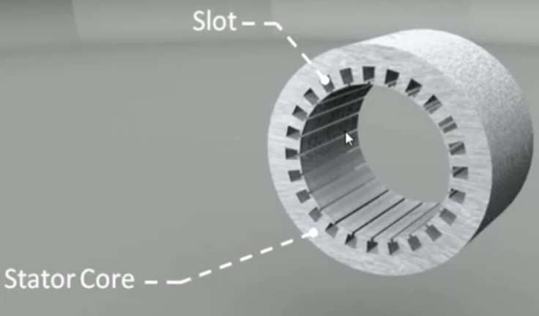

Slide 9
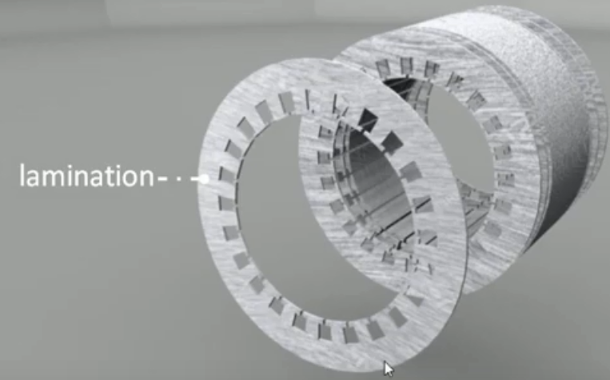

Slide 10
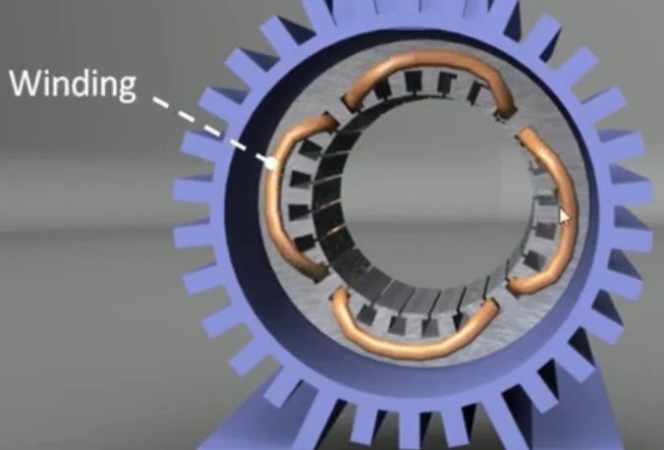
R

Slide 11
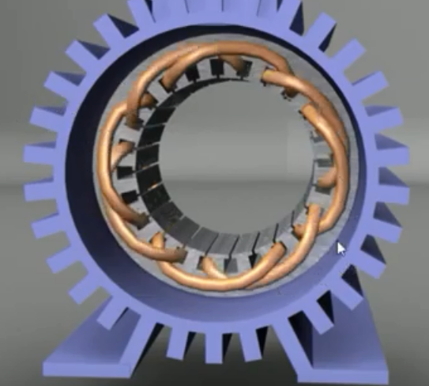
R-Y

Slide 12
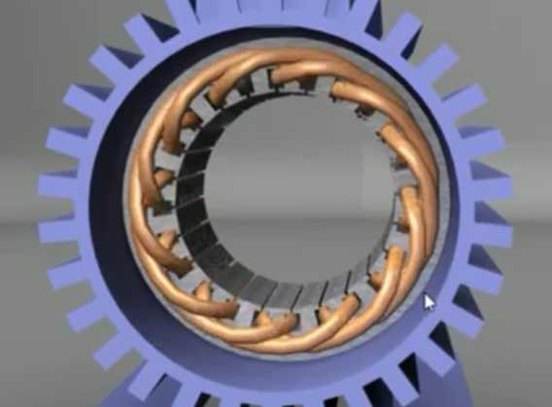
R-Y-B

Slide 13
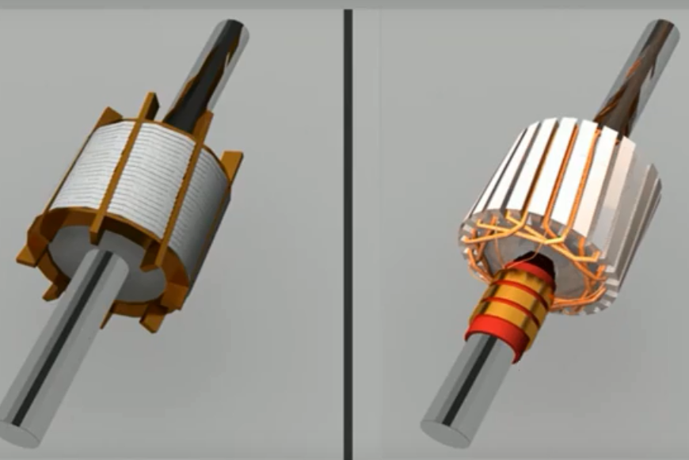
ROTOR

Slide 14
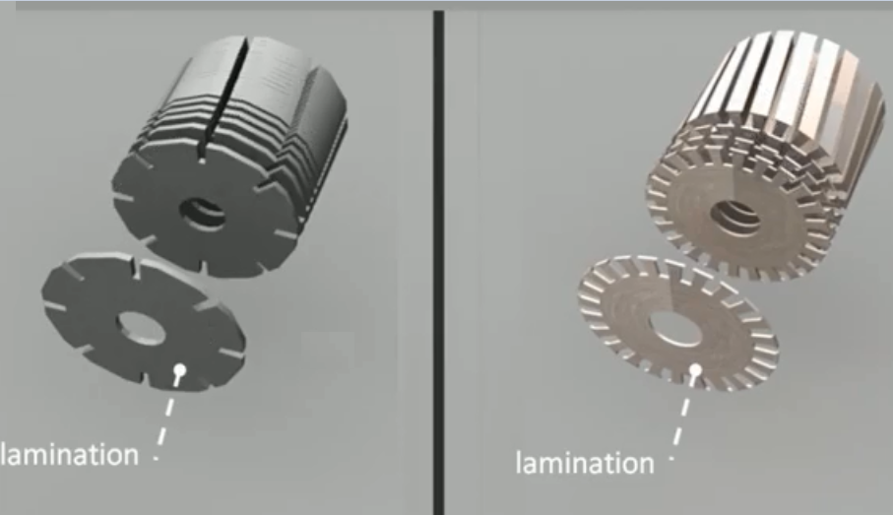

Slide 15
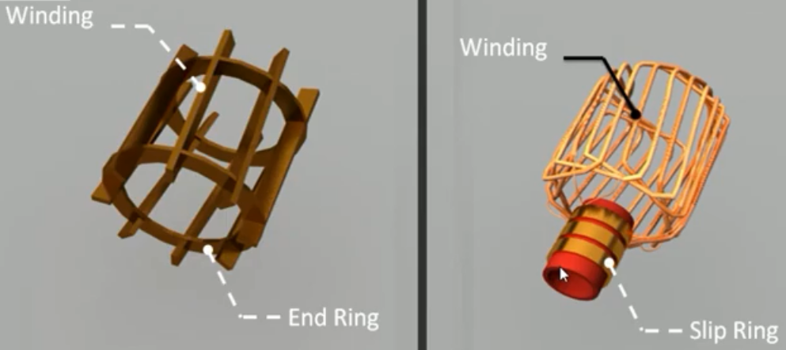

Slide 16
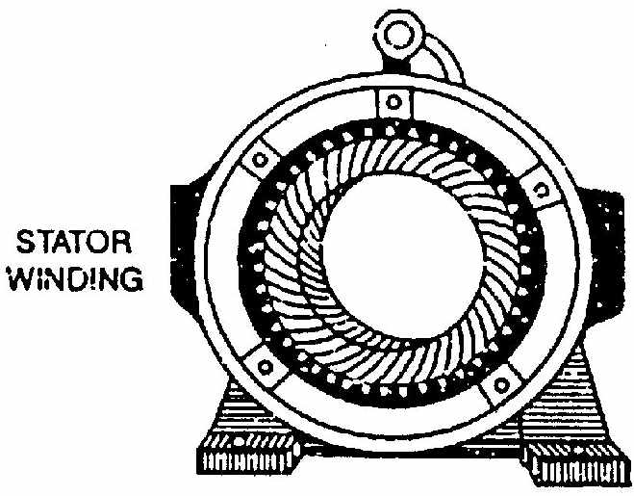
Stator
It consists of a steel frame which encloses a hollow, cylindrical core made up of thin laminations of silicon steel to reduce hysteresis and eddy current losses.

Slide 17
ROTOR
The rotor, mounted on a shaft, is a hollow laminated core having slots on its outer periphery. The winding placed in these slots (called rotor winding) may be one of the following two types:
(1) Squirrel cage type (2) Wound type

Slide 18
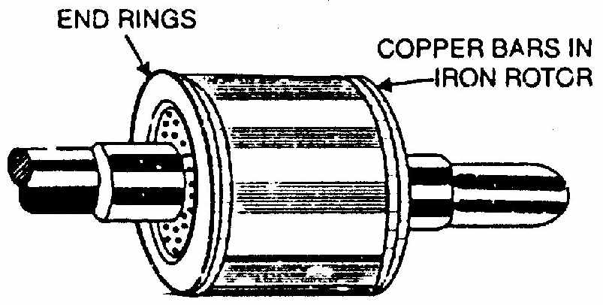
(1) Squirrel cage type
Squirrel cage rotor.
It consists of a laminated cylindrical core having parallel slots on its outer periphery. One copper or aluminium bar is placed in each slot. All these bars are joined at each end by metal rings called end rings. This forms a permanently short-circuited winding which is indestructible. The entire construction (bars and end rings) resembles a squirrel cage and hence the name. The rotor is not connected electrically to the supply but has current induced in it by transformer action from the stator.

Slide 19
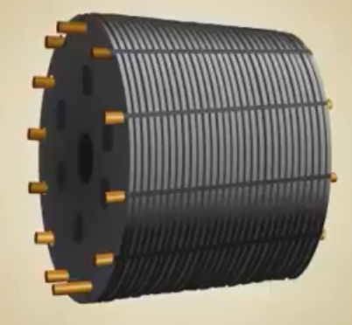

Slide 20
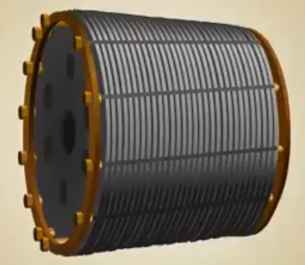

Slide 21
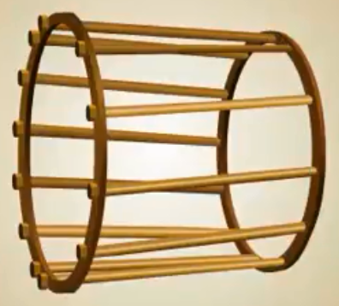

Slide 22
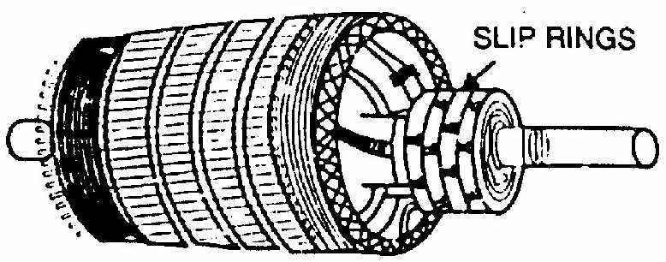
(2) Wound type
Wound rotor
It consists of a laminated cylindrical core and carries a 3-phase winding, similar to the one on the stator. The rotor winding is uniformly distributed in the slots and is usually star-connected.
The open ends of the rotor winding are brought out and joined to three insulated slip rings mounted on the rotor shaft with one brush resting on each slip ring. The three brushes are connected to a 3-phase star-connected rheostat as shown in Fig. At starting, the external resistances are included in the rotor circuit to give a large starting torque. These resistances are gradually reduced to zero as the motor runs up to speed.

Slide 23
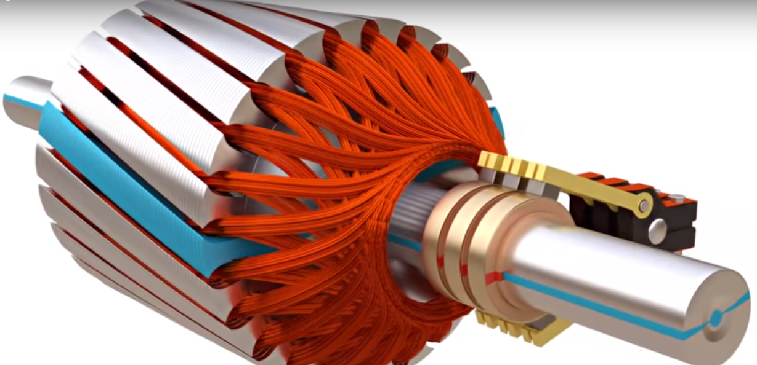
Wound type (slip ring induction motor)

Slide 24
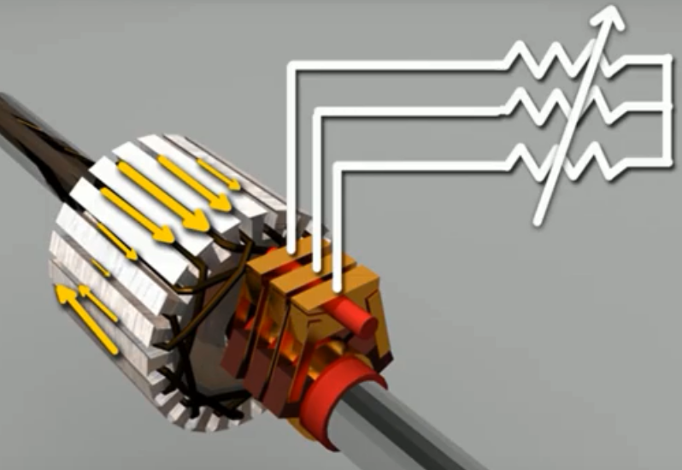

Slide 25
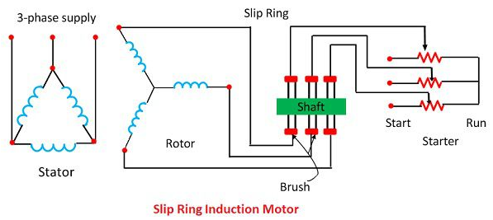

Slide 26
Sr. No. | Squirrel Cage Induction Motor | Slip Ring / Wound Rotor Induction Motor
1) | In Squirrel cage induction motors the rotor is simplest and most rugged in construction. | In slip ring induction motors the rotor is wound type. In the motor the slip rings, brushes are provided. Compared to squirrel cage rotor the rotor construction is not simple.
2) | Cylindrical laminated core rotor with heavy bars or copper or Aluminum or alloys are used for conductors. | Cylindrical laminated core rotor is wound like winding on the stator.
3) | Rotor conductors or rotor bars are short circuited with end rings. | At starting the 3 phase windings are connected to a star connected rheostat and during running condition, the windings are short circuited at the slip rings.
4) | Rotor bars are permanently short circuited and hence it is not possible to connect external resistance in the circuit in series with the rotor conductors. | It is possible to insert additional resistance in the rotor circuit. Therefore it is possible to increase the torque; the additional series resistance is used for starting purposes.
5) | Cheaper cost. | Cost is slightly higher.

Slide 27
6) | No moving contacts in the rotor. | Carbon brushes, slip rings etc are provided in the rotor circuit.
7) | Higher efficiency. | Comparatively less efficiency.
8) | Low starting torque. It has 1.5 time full load torque. | High starting torque. It can be obtained by adding external resistance in the rotor circuit.
9) | Speed control by rotor resistance is not possible. | Speed control by rotor resistance is possible.
10) | Starting current is 5 to 7 times the full load current. | Less starting current compared to squirrel cage Induction Motor.

Slide 28
Rotating Magnetic Field Due to 3-Phase Currents
When a 3-phase winding is energized from a 3-phase supply, a rotating magnetic field is produced.
This field is such that its poles do not remain in a fixed position on the stator but go on shifting their positions around the stator. For this reason, it is called a rotating Held.
It can be shown that magnitude of this rotating field is constant and is equal to 1.5 φm where φm is the maximum flux due to any phase.

Slide 29
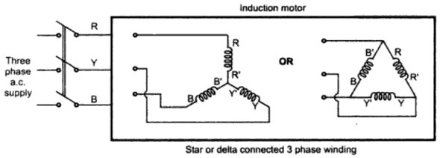
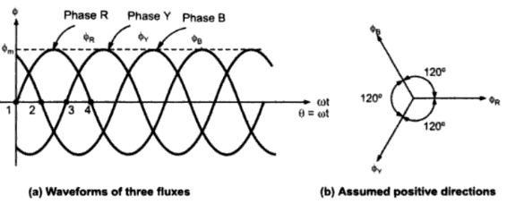
Stator Supply

Slide 30
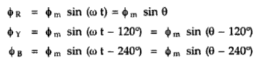
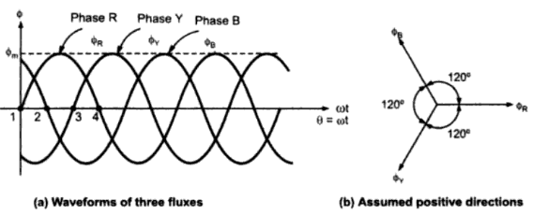

Slide 31
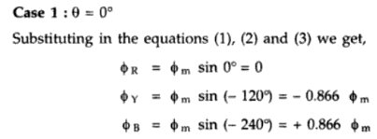

Slide 32
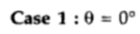
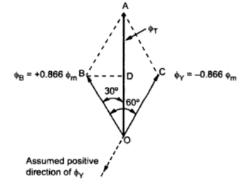
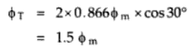

Slide 33
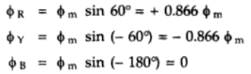

Slide 34
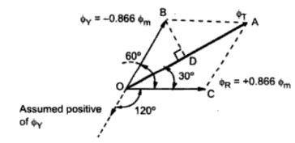

Slide 35
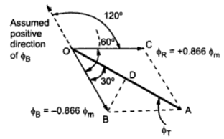

Slide 36
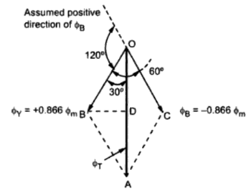

Slide 37
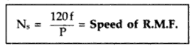
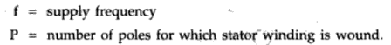

Slide 38

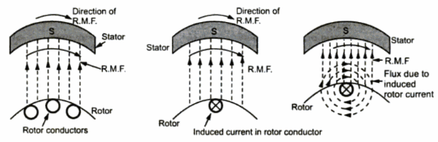
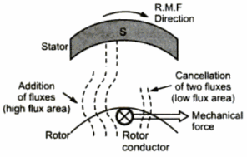

Slide 39
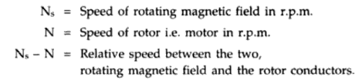
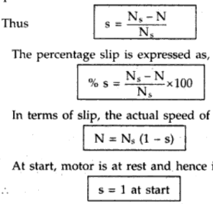

Slide 40
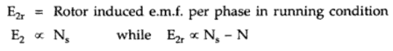
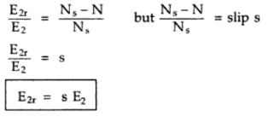

Slide 41
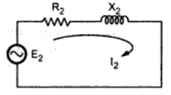
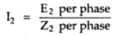
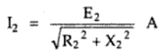

Slide 42
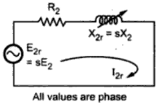
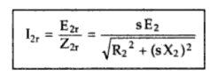

Slide 43
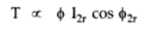
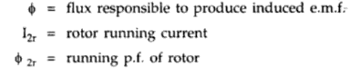
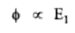
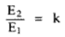
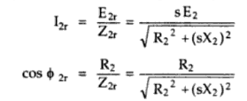

Slide 44
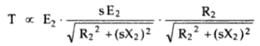




Slide 45


Slide 46
REFERENCES
https://www.youtube.com/watch?v=CL2YEx4ul80
https://www.youtube.com/watch?v=AQqyGNOP_3o
https://www.youtube.com/watch?v=JPn5Ou-N0b0
https://www.youtube.com/watch?v=QLvWGFD4Qyo
https://www.youtube.com/watch?v=MEoKTdJgf5s
https://www.youtube.com/watch?v=R9-TozphVmk
https://www.youtube.com/watch?v=LtJoJBUSe28

